Slide 1



32 Bit CPU using Verilog
“CPU DESIGN USING
VERILOG ”
Name
Vrindesh Malik

Slide 2


About Project
The main Aim of this CPU design is to execute Arithmetic Logic Unit (ALU) operations efficiently, store the computed results in memory, and facilitate subsequent access to these stored values for further processing. Additionally, the CPU is capable of performing new ALU operations using previously stored results, allowing for iterative computations and data manipulation. The design also supports modifying the contents of the stored memory, ensuring flexibility in handling complex computational tasks and dynamic data management. This capability enhances the system's overall functionality, making it suitable for a wide range of applications that require continuous processing and adaptive memory
Verilog Hardware Description Language and HDLIn this project Xilink Vivado software is used. Vivado Design Suite is a software suite for synthesis and analysis of designs based on Verilog .

Slide 3

About VLSI
Definition:
VLSI stands for Very Large Scale Integration, a process of creating integrated circuits (ICs) by combining
thousands to millions of transistors on a single chip.
Evolution:
VLSI technology evolved from earlier technologies such as SSI (Small Scale Integration), MSI
(Medium Scale Integration), and LSI (Large Scale Integration), which integrated fewer components.
Importance:
VLSI technology is crucial for the development of modern electronics, enabling the creationof compact,
high-performance, and power-efficient devices like smartphones, computers, and other digital systems.
Applications:
VLSI is used in various applications including microprocessors, memory chips, digital signal processors
(DSPs), application-specific integrated circuits (ASICs), and field-programmable gate arrays (FPGAs).

Slide 4
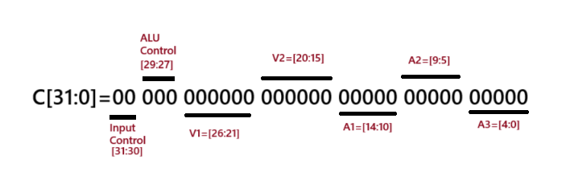
32 bit CPU OPCODE
WHAT is an OPCODE
An opcode, or operation code, is a numeric code that tells a processor what operation to perform
An opcode is a binary or hexadecimal number that represents a specific instruction for a processor to perform

Slide 5
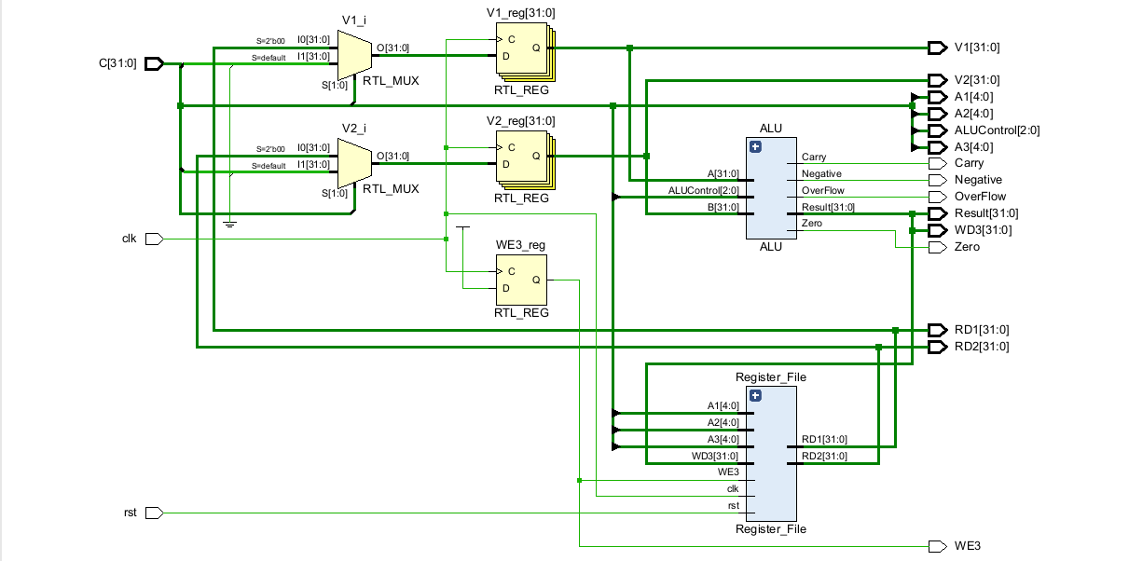
Circuit Diagram

Slide 6
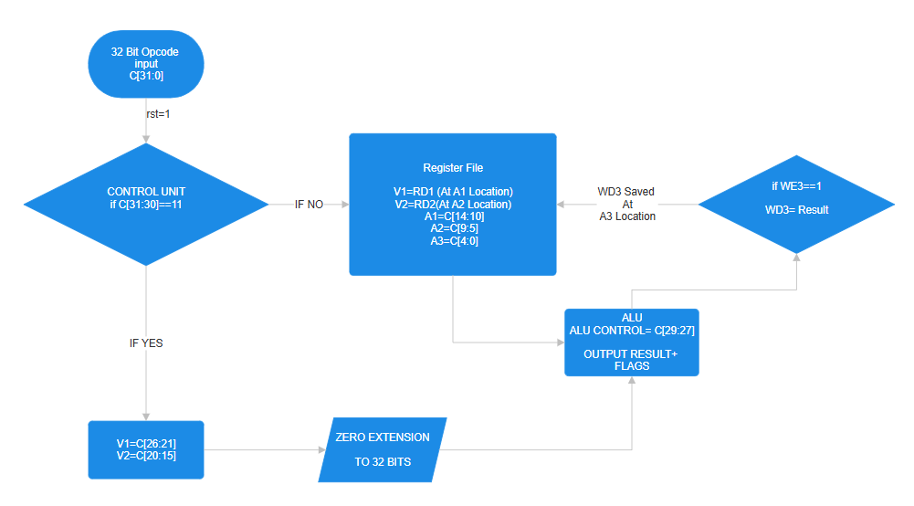
Flow Chart

Slide 7
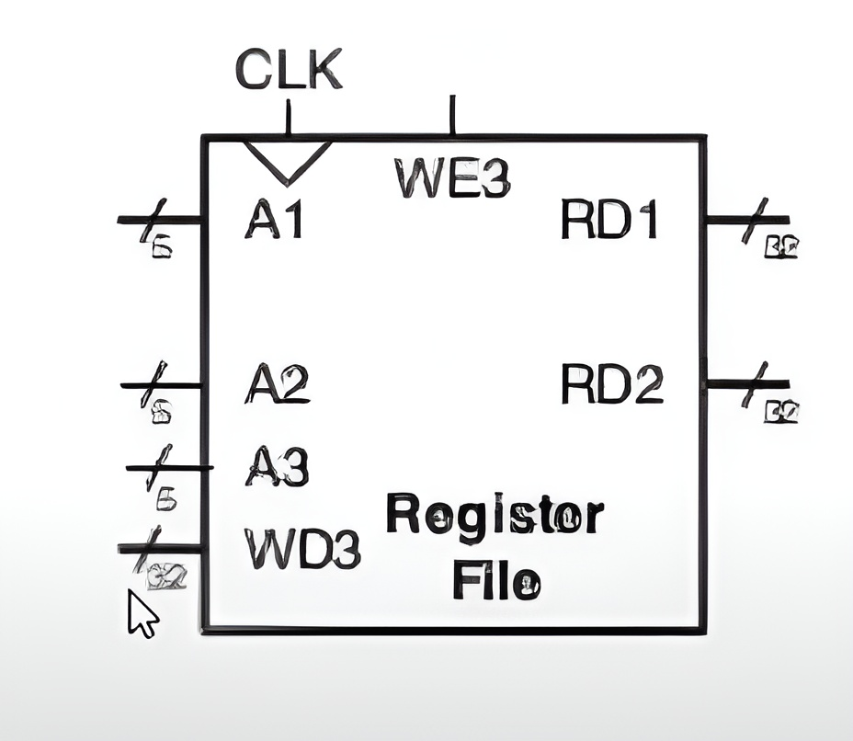
Parts of Circuits - Register File (Memory)
It performs following operations
Read Operation​
RD1= Read Port 1 (It reads location given at A1)​
RD2= Read Port 2 (It reads location given at A1)
Write Operation
If WE=1 and rising edge of clk is there
The data given at WD3 will be saved at A3 location

Slide 8
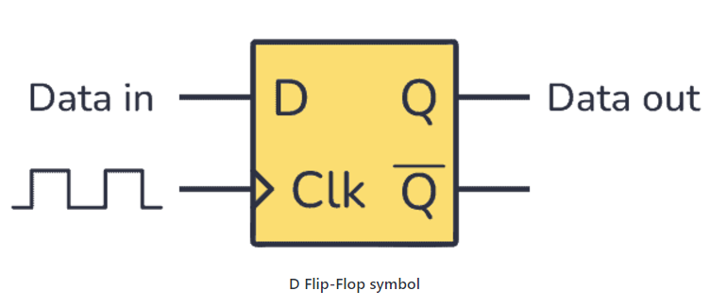
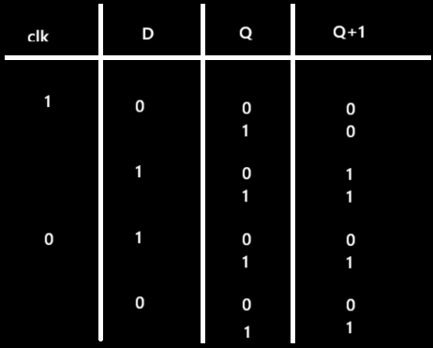
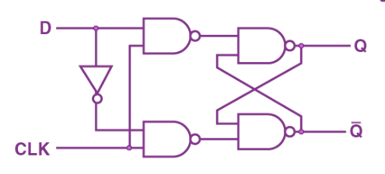
Building of Register(RAM)
File
1) Registers using D flipflop
2) MUX
3) Decoder
If clock ==1
Q+1=D
Otherwise
Q+1=Q
-D FlipFlop

Slide 9
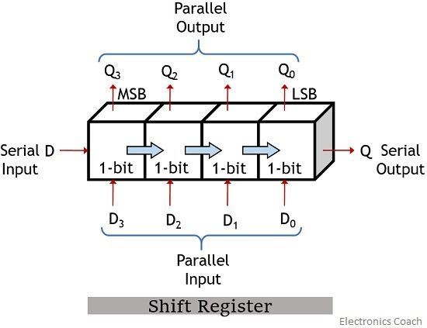
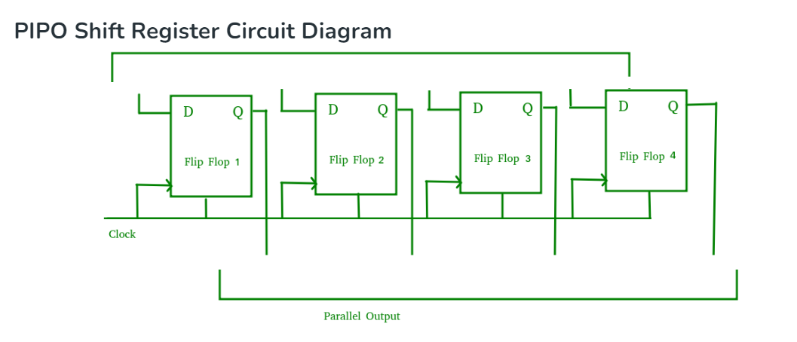
Parallel in Parallel out Register

Slide 10
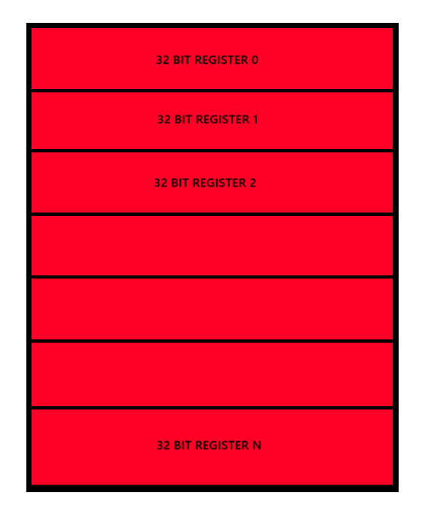
BY COMBINING THESE SHIFT REGISTER WE GET
It has 32 D FilpFlops in a Row
It has N Rows
So it can store 32 bits in a
Row

Slide 11
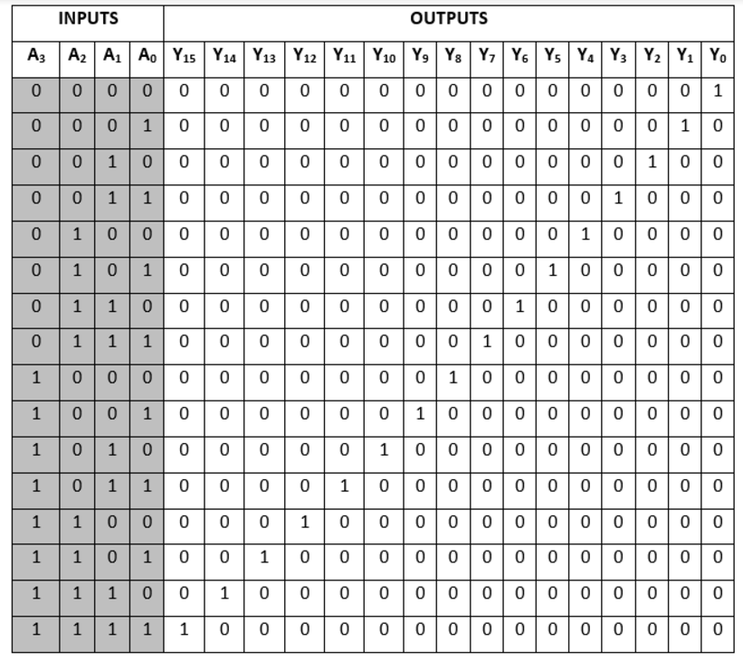
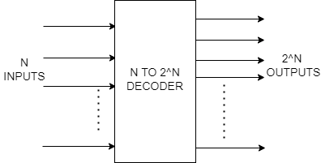
Decoder

Slide 12
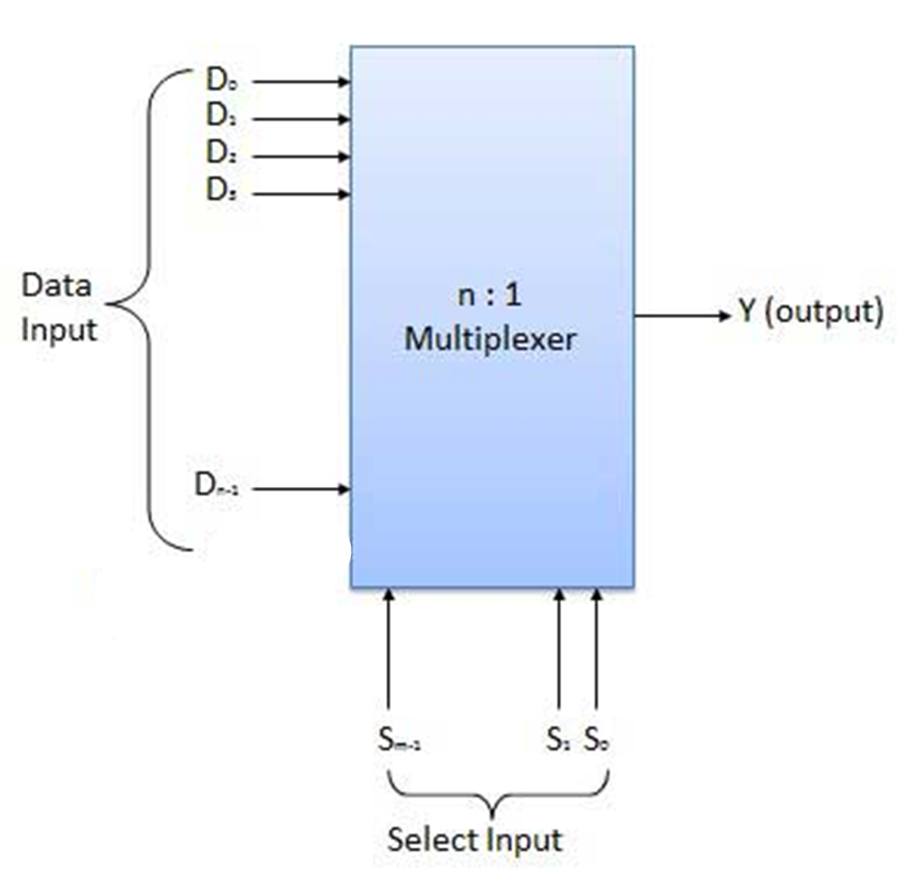
Mux
Many to One
It has N inputs and Only one Output
It will take select the input line with the help
of select lines

Slide 13
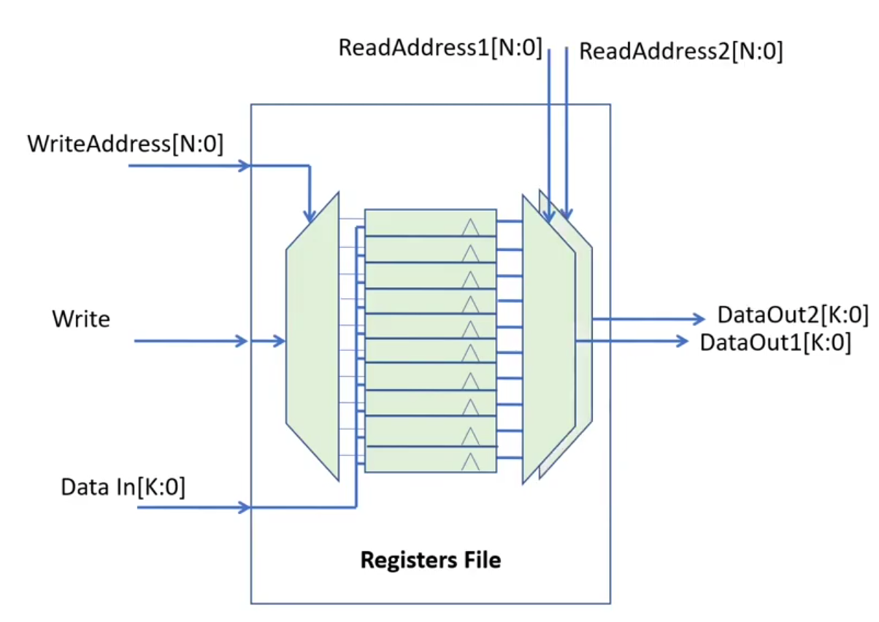
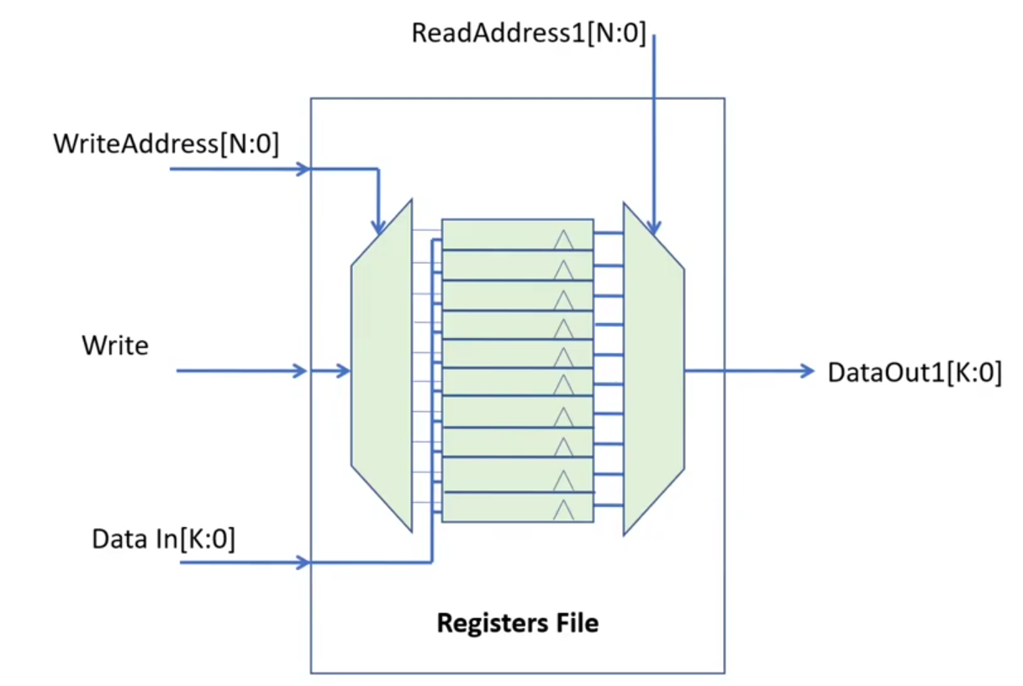
If we combine all these Parts It will
look like
Decoder is Connected to
Clock of register(as write port)
Data In is connected to D’s of shift
Register
Mux input lines are connected to Q
Port of Register
Register with 2 read ports will look like

Slide 14
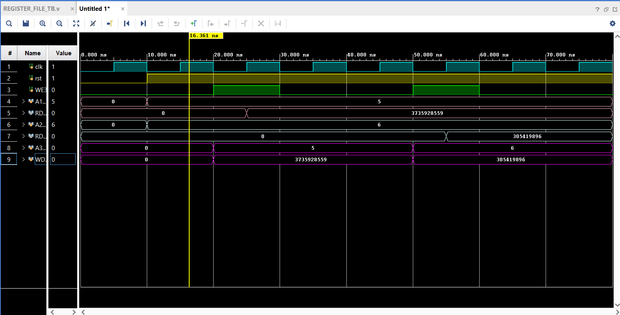
Final Output For Register

Slide 15

What is ALU
ALU stands for Arithmetic Logic Unit, which is a digital circuit that performs arithmetic and logical operations in a computer's central processing unit (CPU). ALUs are a fundamental building block of many computing circuits, including graphics processing units (GPUs) and floating-point units (FPUs)
Operations List:
1. Addition (`ALUControl = 3'b000`)
2. Subtraction(`ALUControl = 3'b001`)
3. Bitwise AND (`ALUControl = 3'b010`)
4. Bitwise OR (`ALUControl = 3'b011`)
5. Multiplication** (`ALUControl = 3'b100`)
6. Set on Less Than (SLT)(`ALUControl = 3'b101`)
7. Division (`ALUControl = 3'b110`)
8. Modulus(`ALUControl = 3'b111`)
ALU
Arithmetic Logic Unit

Slide 16
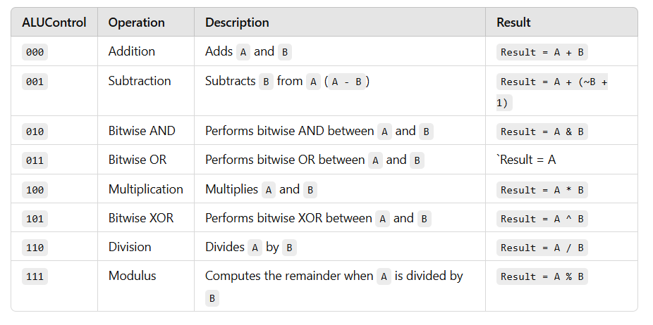
ALU Operations
C=[29:27]

Slide 17
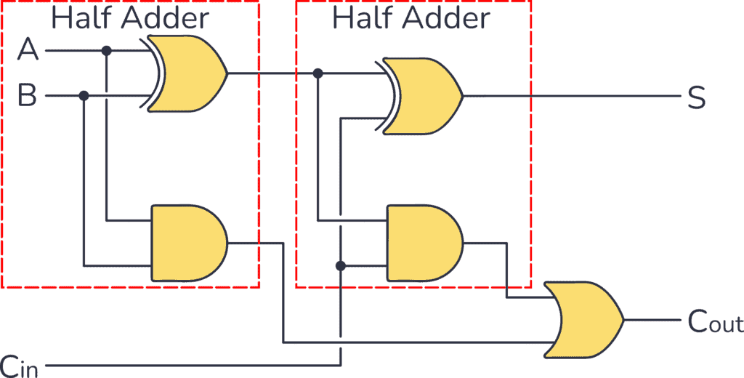
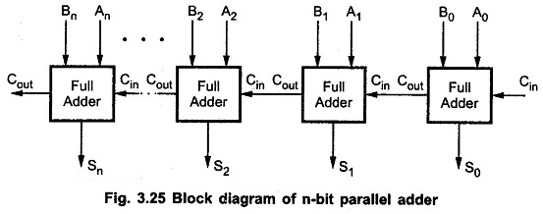
Addition diagram

Slide 18
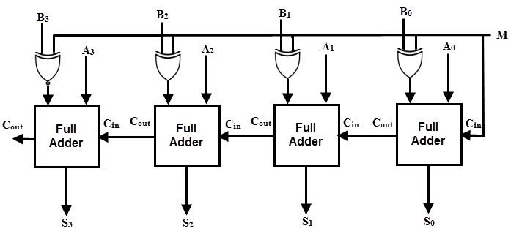
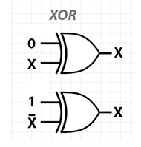
Subtraction diagram

Slide 19
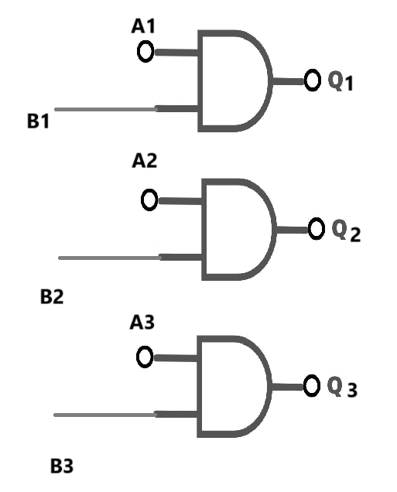
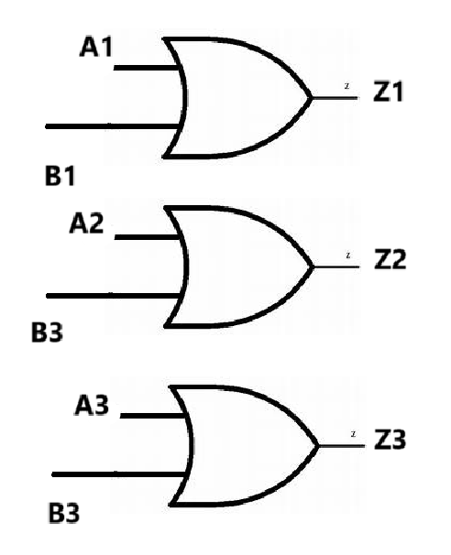
Bitwise And Or Circuit
Bitwise And Circuit
Bitwise Or Circuit

Slide 20
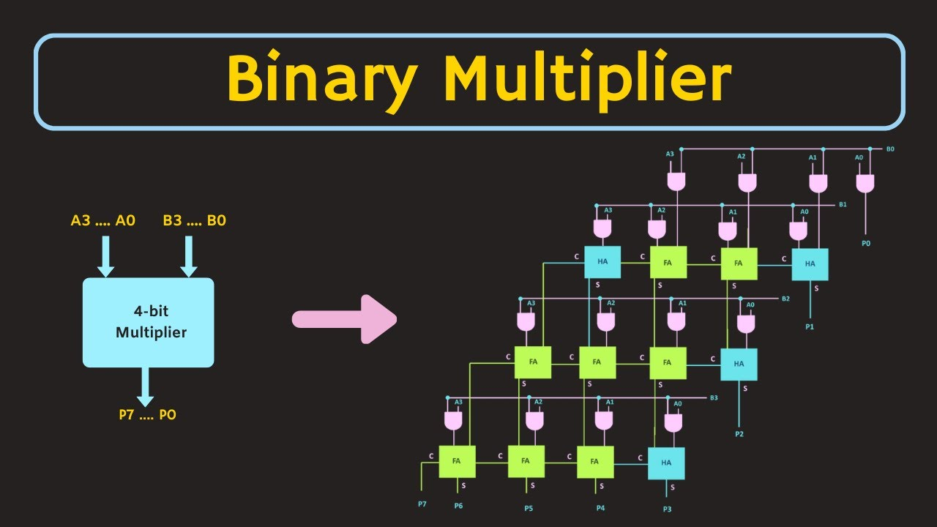
Multiplier Circuit

Slide 21
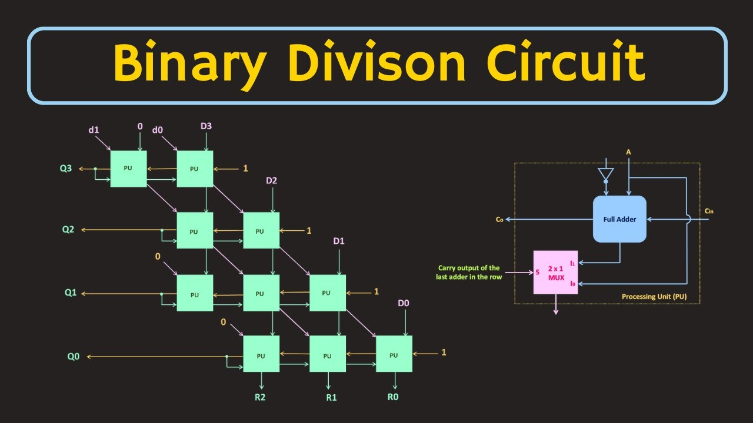
Divisor /Modulus Circuit

Slide 22
ALU Output

Slide 23
Control Unit
Key Functions:
Instruction Decoding: Interprets the binary instruction (input C) and generates control signals for various CPU components.
2.Signal Generation:
ALU Control Signals: Determines the operation to be performed (e.g., addition, subtraction).
Register Control Signals: Manages read and write operations in the register file.
3.Data Flow Control: Determines which data to use as inputs for the Arithmetic Logic Unit (ALU) and where to store the results.
Memory Control Signals: Coordinates memory read/write actions.

Slide 24

Control Unit Integrated Elements
Zero Extension
Mux/Demux
Multiplexer (MUX): Selects one input from multiple sources based on control signals.
Demultiplexer (DEMUX): Routes a single input to one of multiple outputs based on control signals.
Zero extends an N-bit input to 32 bits, padding with leading zeros.
Clk
Opcode Distributer
Clock (CLK): Provides timing signals to synchronize operations in digital circuits. Generates a periodic waveform to control data flow and state transitions.
Decodes an instruction's opcode to control signals. Directs the operation flow to specific functional units in a CPU.

Slide 25
Opcode Distribution

Slide 26
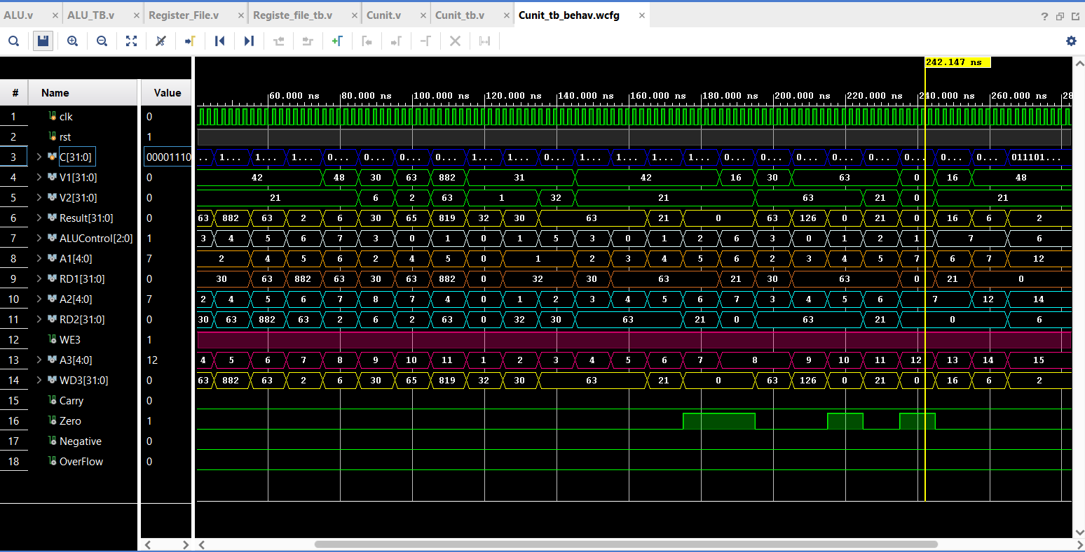
Final Output

Slide 27
Conclusion
This project successfully demonstrates the design and implementation of a simplified CPU, focusing on core functionalities like ALU operations, register file interactions, and control unit coordination. The CPU efficiently performs arithmetic and logical operations, stores results in memory, and retrieves them for subsequent processing. Key highlights include:
-ALU Functionality: The ALU supports essential operations such as addition, subtraction, bitwise AND, bitwise OR, multiplication, division, and modulus. The inclusion of flags (Carry, Overflow, Zero, and Negative) ensures accurate status monitoring for each operation.
-Control Unit Efficiency: The control unit orchestrates data flow between the ALU, registers, and memory. It decodes instructions, manages control signals, and ensures synchronized execution, highlighting the importance of instruction handling in CPU design.
-Register File Utilization: The register file allows efficient data storage and retrieval, supporting seamless interaction with the ALU. The ability to modify and access stored results enhances the CPU's computational flexibility.

Slide 28
THANK YOU
for your time and attention

